Slide 1
SNAP MAP
Team: Donuts and Data Division
Ari Anisfeld, Jasmin Dial, Emma Peterson, Joan Wang
Notes:
Joan

Slide 2
Agenda
Goal
Outcome
Technical details
Data sources
App structure
Struggles and lessons
Future improvements
Notes:
Jazz

Slide 3
Where we started
Create a tool that eases the process of locating and utilizing community-resources for low-income individuals.
Notes:
Jazz

Slide 4
Goal
Focus on locating retailers that accept SNAP (Supplemental Nutrition Assistance Program) benefits
Create tool that helps users optimize value of SNAP benefits
Notes:
-Talk about how Charlie said there’s a need for it
-input from reddit
-based on easily available data
Jazz

Slide 5
DEMO TIME!
Notes:
Ari

Slide 6
Outcome – Mapping
Improved accuracy of retailer information
Additional information when available
Search/filter options
Flexible geographic search options through SpatiaLite
Improved Farmer’s Market data
Notes:
Emma
Names and addresses were wrong/weirdly formatted
(contact info, hours, category, review score, cost, website)
Filter by category, cost, rating
Use google autocomplete to allow search by neighborhood, address without zipcode (not available on govt website)
Add farmer’s markets that weren’t listed by USDA and highlights those accepting double value coupons
Emma

Slide 7
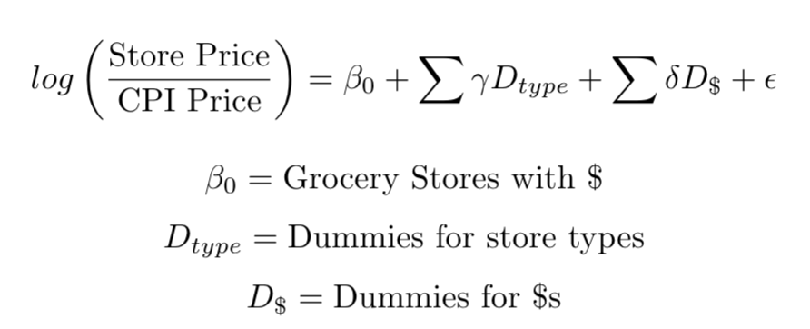
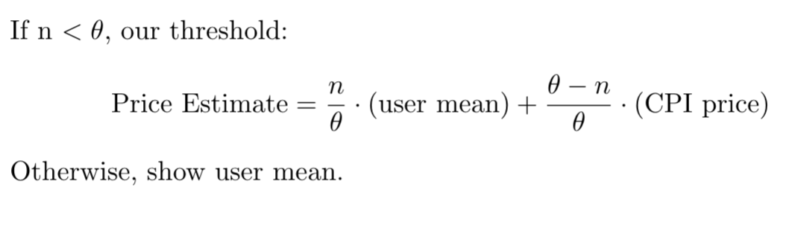
Outcome – Grocery List & Price Contributions
More specific price estimates
Dimensions: store type & price level
Field research
Regression to estimate multipliers
User-contributed prices to improve accuracy
Notes:
Joan
Intro: in attempt to make price estimates at stores more accurate, we employed a few different mechanisms
Allows users to create and calculate total cost of grocery list of common eligible food items
Prices for individual stores estimated according to CPI prices, type of retailer, and price category
Visited a few different types of stores of varying price categories to help inform our regression
Regression allowed us to fill the database with estimated prices for each food type at each of the 2000+ stores, prior to user input
Accepts user-submitted price data to improve accuracy of food costs for individual stores
Until a sufficient number of users submit a price for a particular food at a particular store, the initial estimate is weighted more heavily to ensure that it’s relatively consistent
OTHER BENEFITS: totals calculated w/o tax (SNAP user’s don’t pay tax), grocery lists specific to items ELIGIBLE for SNAP (helps users navigate system)

Slide 8
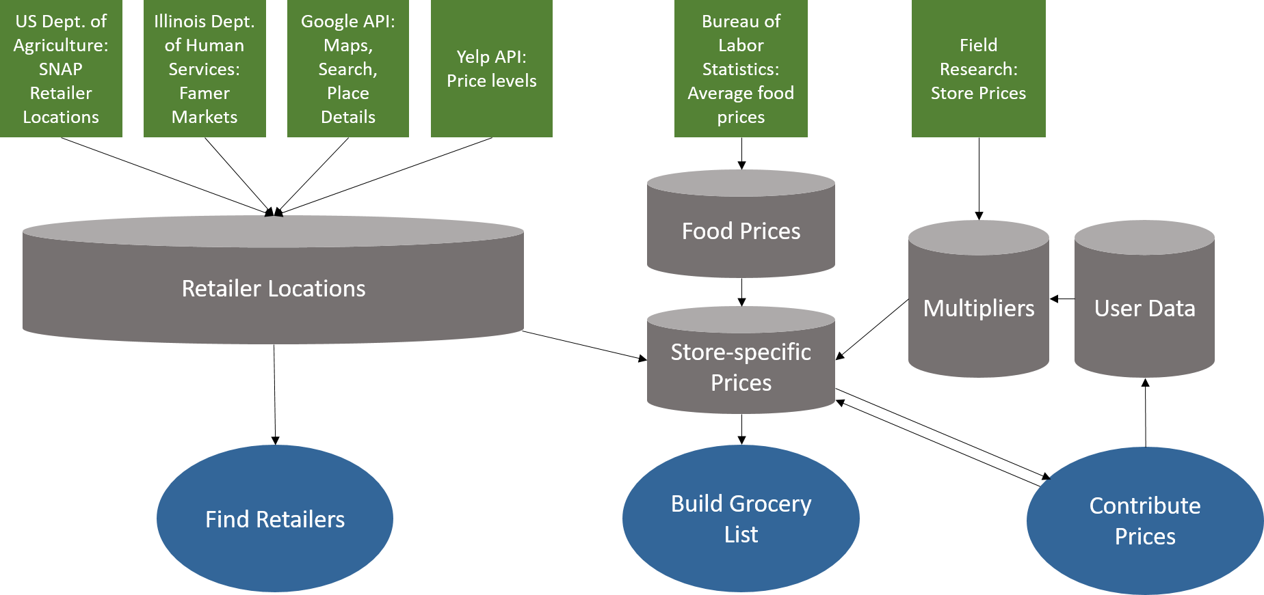
Structure
Notes:
Joan

Slide 9

Challenge: Record Linkage
Notes:
-Farmer’s Markets
-Google API troubles

Slide 10
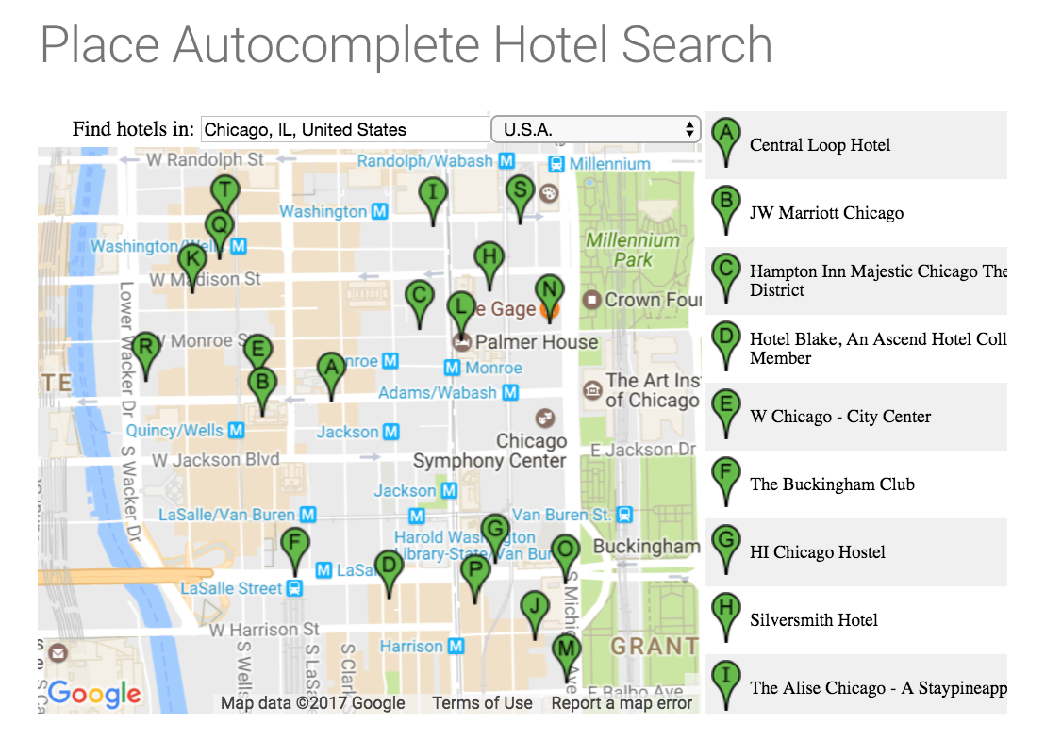
Challenge: Google API + Javascript
Notes:
Joan
Wanted a pretty interactive map -- looked into leaflet for a long time and tried to learn it
Then realized that in order to use Google places autocomplete, which we really wanted to improve user experience, needed to use a google map (per restrictions in their documentation)
-- Lesson: read documentation carefully earlier on
Then, found great example
Understanding sample javascript
Trying to customize to django for our specific non-google needs
-- Lesson: taking samples is never as easy as it seems...
Capturing form data to send to backend (filter) - pass on to Ari

Slide 11
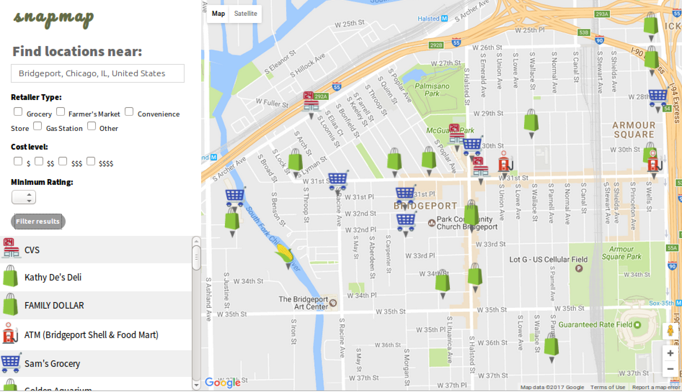
Challenge: How to get a map to speak to a database
Notes:
One of the first challenges we considered -- How do we get a map to speak to a database
Background in using mapping software, so I had it in my head that we needed a geodatabase.
Desired outcome, do better than haversine function -- want to get data for whole map seen, let users zoom etc arbitrarily.

Slide 12
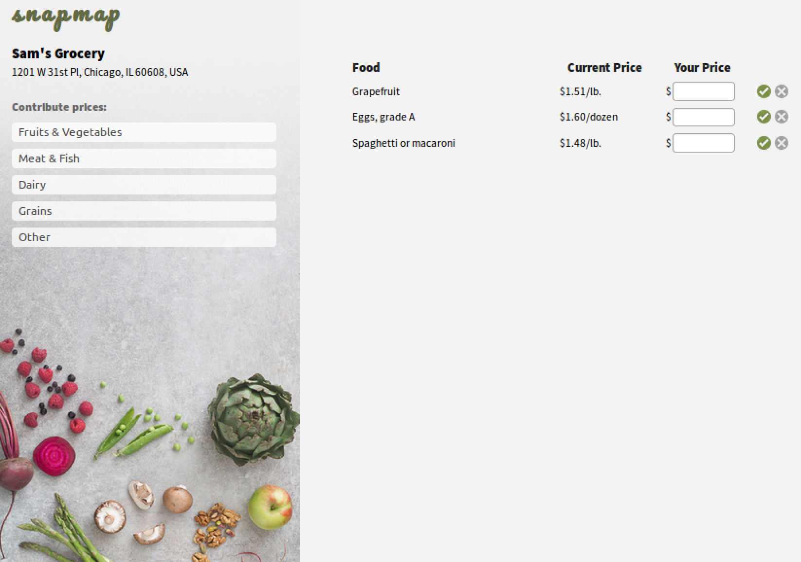
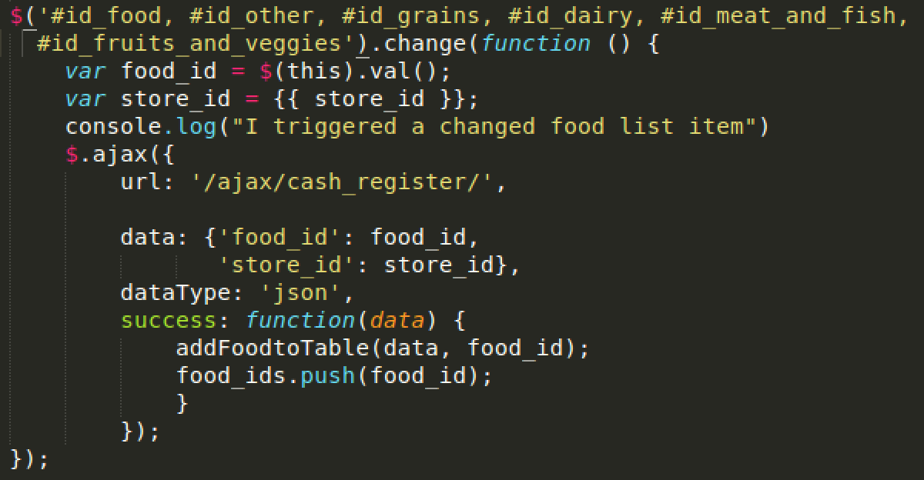
Challenge: FrontEnd to BackEnd Communication
Notes:
Emma
Grocery list page and price submission page require taking user input and pulling data from the database and then updating the page that the user is interacting with
Javascript/ajax: ability to access the information currently on the page and update it immediately based on the user’s selections
Utilized console log messages and print statements in various places in the code in order to help visualize the process and understand where it’s getting stuck

Slide 13
Future of snapmap
Improved accuracy of retailer information
Leverage user input for important features
Tailored grocery list
More field research
Expand to other cities
Automatic refreshing of source data
Migrate to PostGre/PostGIS and make site public
Notes:
Record linkage, remove duplicates, add website for Farmer’s Market or when data not available,
user input to recalculate prices for individual stores and multipliers for categories,
-user input to indicate whether stores not in business
-user input to indicate fresh produce or relevant specials (e.g. bargain produce)
- user input to determine the correct store prices (weight more recent data points more
3) determine foods typically available for each type of store (field research)?
-more reasonable units for foods (e.g. oz vs lbs)
-user input for special exceptions
-Use city-specific CPI data
5) make a wedapp that people can actually use
Automatic refreshing: Google Places info, USDA prices,
Jazz

Slide 14
Questions? Input?

